Slide 1

PhishShield
Stop Phishing in Real Time
Secure our organization with advanced phishing defense

Slide 2

Problem Statement
The Phishing Threat Landscape
3.4B
83%
$4.9M
Phishing emails daily
Organizations targeted
Average data breach cost
Global volume continues rising exponentially
Experience phishing attacks annually
When phishing attacks succeed

Slide 3

PhishShield Solution Overview
Real-Time Protection
User-First Design
Instant URL analysis using advanced machine learning algorithms that identify phishing attempts before users interact with malicious content.
Seamless browser integration with minimal performance impact, providing clear warnings without disrupting normal browsing workflows.
PhishShield transforms cybersecurity from reactive to proactive, stopping threats at the moment of click with intelligent, real-time decision making.

Slide 4

Why Current Protections Fall Short
Response Delays
High False Positives
Traditional blacklists update hours or days after threats emerge, leaving users vulnerable during critical windows.
Overly aggressive filters block legitimate sites, disrupting productivity and eroding user trust in security systems.
Static Detection Methods
Legacy systems rely on known threat signatures, failing against new phishing techniques and zero-day attacks.

Slide 5
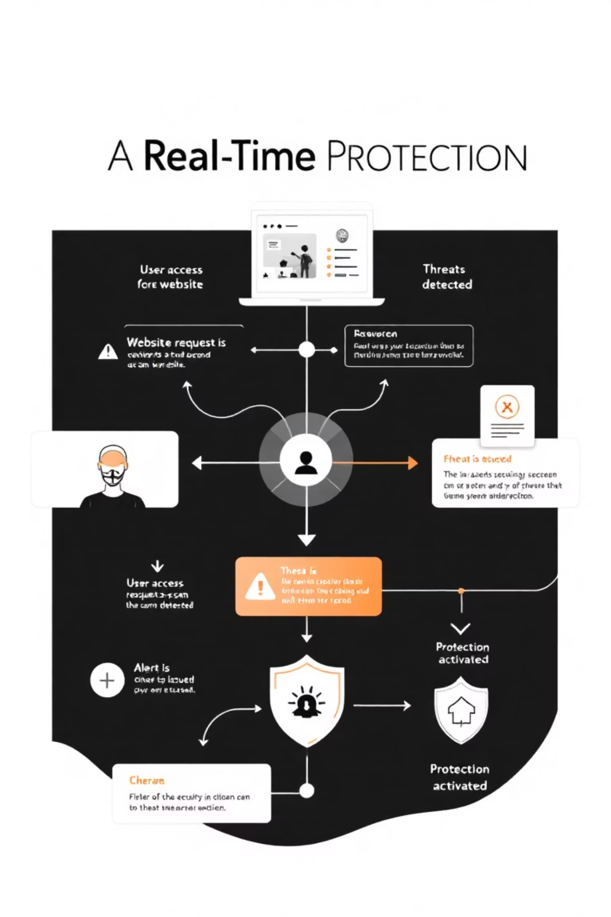



How PhishShield Works
User Clicks URL
Extension intercepts the request instantly without user awareness or delay.
Instant URL Scan
AI engine analyzes URL structure, domain reputation, and content patterns in milliseconds.
Smart Decision
Algorithm determines action: allow safe sites, warn about suspicious content, or block confirmed threats.

Slide 6

Technical Architecture
Browser Extension
Monitors URL requests
Response Returned
Request Sent to API
PhishShield Data Flow
Decision in milliseconds
Secure, low-latency call
ML Scoring Engine
API Gateway
Scalable routing & auth
Real-time threat analysis
Browser Layer
API Gateway
ML Engine
Lightweight extension monitors URL requests without affecting performance or user experience.
Scalable cloud infrastructure processes millions of requests with 99.9% uptime reliability.
Advanced neural networks trained on billions of threat patterns deliver instant, accurate decisions.

Slide 7





Core Features & Capabilities
Sub-Second Detection
Advanced ML algorithms analyze threats in under 100ms, providing instant protection without browsing delays.
Adaptive Learning
Machine learning engine continuously evolves, learning from new threats to improve accuracy and reduce false positives.
Lightweight Design
Minimal resource footprint ensures smooth performance across all devices without impacting browser speed.
Privacy-Safe Operation
Zero data collection of personal browsing habits while maintaining comprehensive threat protection.

Slide 8






Benefits Across our Organization
Business Leaders
Reduced security incidents and costs
Lower breach risk
End Users
Improved productivity
Safe browsing without interruption
Compliance confidence
Instant threat blocking
Clear warning messages
IT Administrators
Zero learning curve
Simplified security management
Central policy control
Detailed reporting
Easy deployment

Slide 9

Product Roadmap
1
Current MVP
Real-time URL scanning with core ML engine deployed across major browsers with 95% accuracy rate.
2
Q2 Enterprise Rollout
Advanced admin dashboard, centralized policy management, and integration with existing security infrastructure.
3
Q4 AI Enhancement
Next-generation neural networks with behavioral analysis and predictive threat modeling capabilities.
Our development strategy focuses on continuous innovation while maintaining the simplicity and effectiveness that makes PhishShield unique in the cybersecurity landscape.

Slide 10
Thank you
Do you have any questions?
jitendranishad347@freepik.com
+91 9131089318
yourwebsite.com
Please keep this slide for attribution

